Slide 1

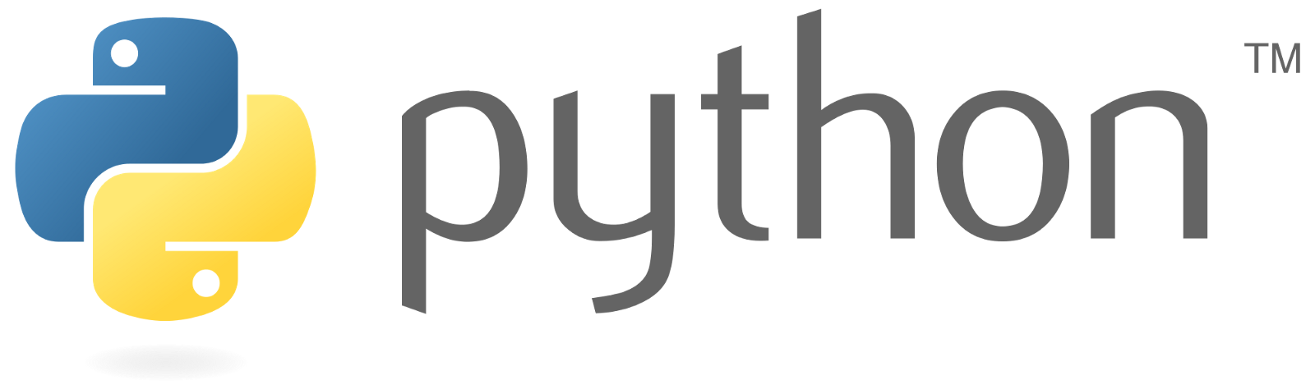

Python 101
Lesson 1: Computer basics & Programming languages

Slide 2
Agenda
The Data Scientist Journey
Computer Basics
Types of Programming Languages
Setting up Python
Python Basics

Slide 3

What is data science?

Slide 4
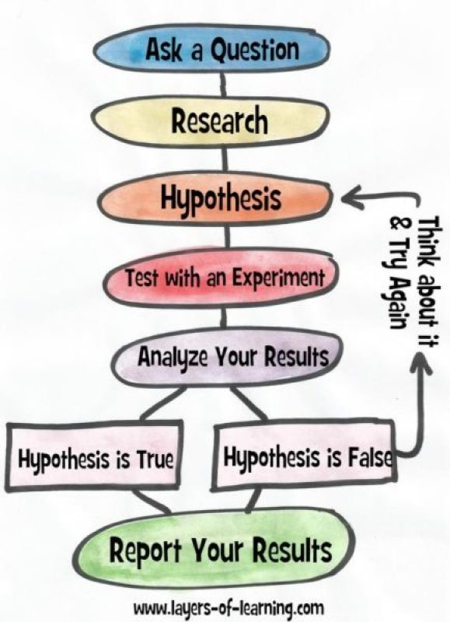
Scientific method

Slide 5
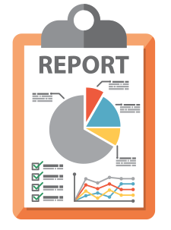
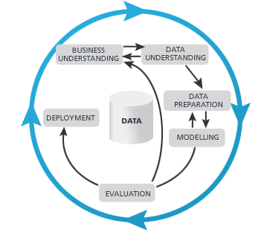


The Data science process
Deployment

Slide 6
Computer basics

Slide 7



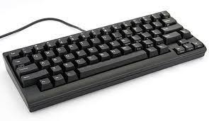
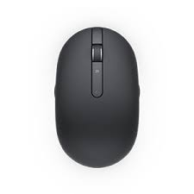
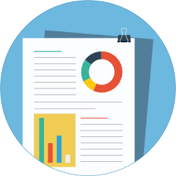
What is a computer?
Input
Output
Compute

Slide 8
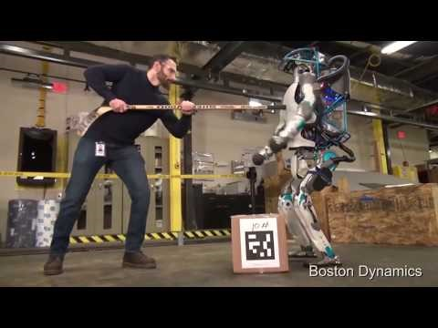

Slide 9
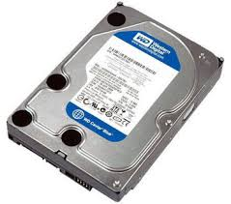
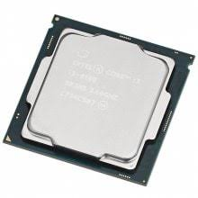

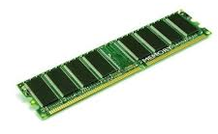
Let’s have a closer look at the magic part
Run Program A
Give me program A
Here’s Program A
Push Program A in Memory
Execute Program A

Slide 10
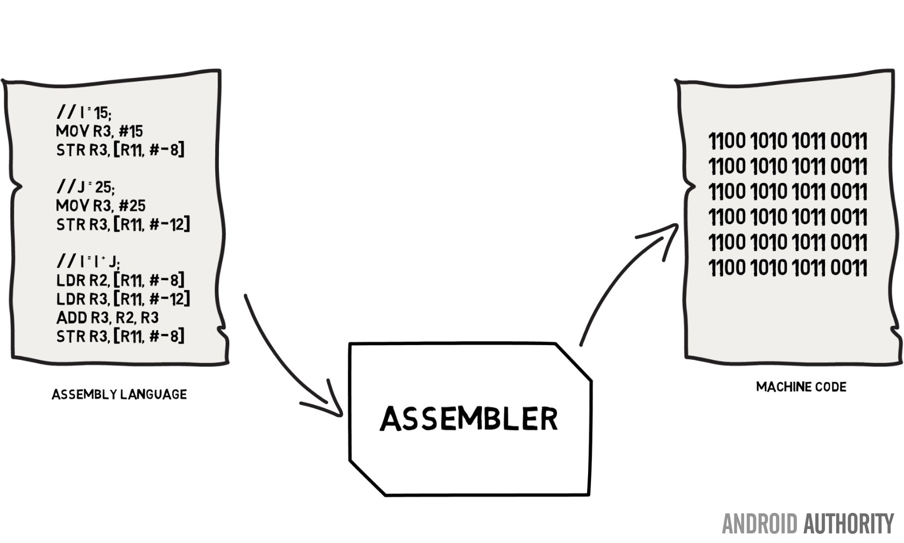
What does program a look like?
Machine Code is impossible to maintain

Slide 11

The way it was

Slide 12
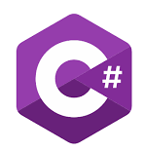




Solution: Create an abstraction
Create human readable languages that is syntactically (grammatically) strong
Translate it into machine code
There are two types of translation for programming language
Compilation
Translation
Once
Code Change
Compiles
Run
Code
Translate
Run

Slide 13
Setting up python

Slide 14
Setting up python (Anaconda)
Downloading Anaconda
Installing Anaconda
Installing Packages
Running Jupyter Notebook
Don’t do this if you use
virtualizations

Slide 15
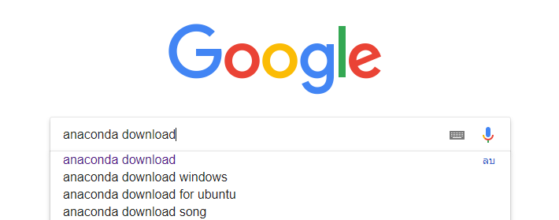
anaconda

Slide 16
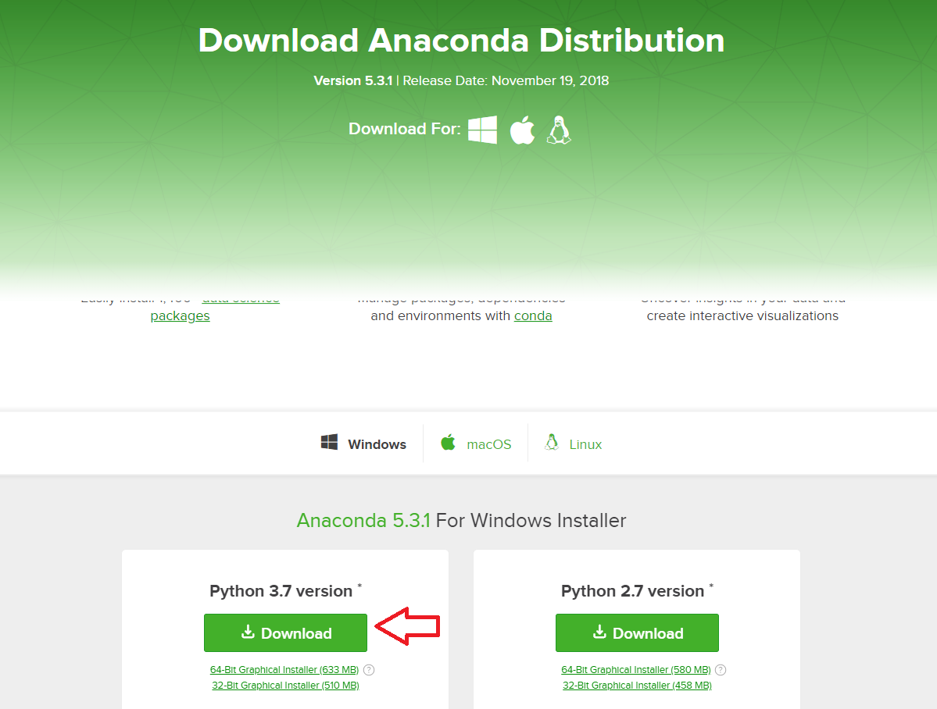

Slide 17
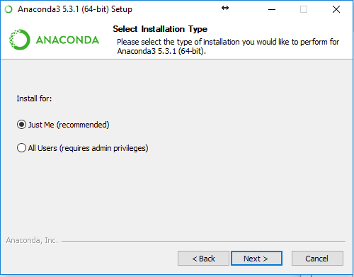

Slide 18
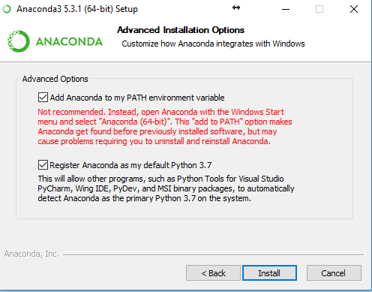

Slide 19
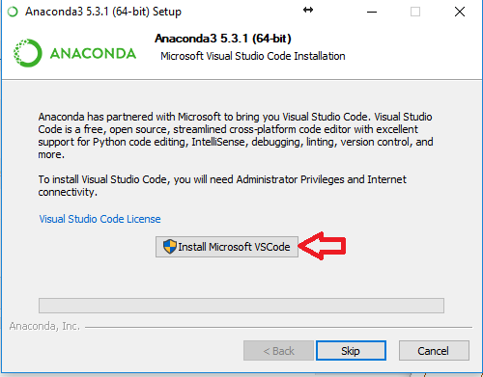

Slide 20
Let’s install some packages
(jupyter) Jupyter Notebook : Workspace
Pandas : 2D Data Tool for Data Analysis
Seaborn, Matplotlib, Chartify : Visualization
Keras : Machine Learning Library Abstraction

Slide 21
Let’s play with jupyter

Slide 22
Python basics : Variables

Slide 23
variables

Slide 24
Control flow

Slide 25
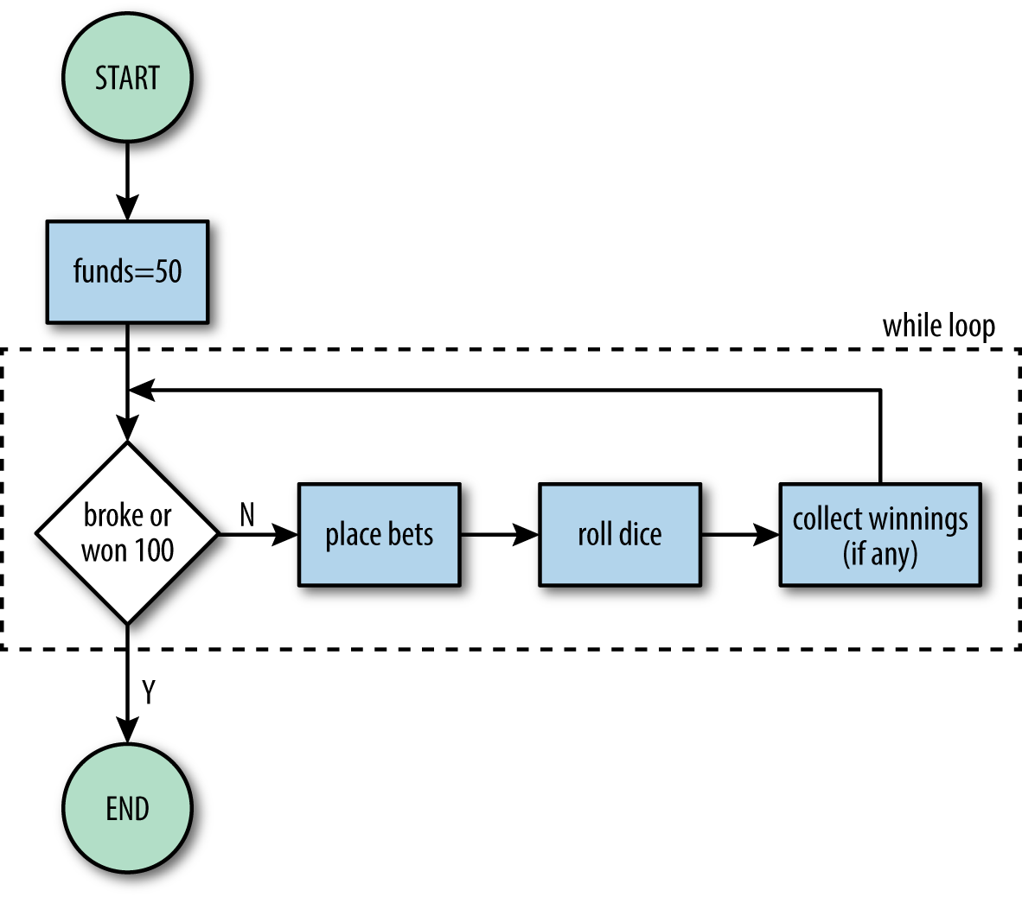
Control flow
If Statement
While
For Loops

Slide 26
Data structure

Slide 27
Data structures
List
Tuples
Set
Dictionary
Pandas Dataframe

Slide 28
functions

Slide 29
functions

Slide 30
appendix

Slide 31
Setting up python (The lean way)
Downloading Python
Installing Python
Using pip (Python Package Manager)
Running Jupyter Notebook

Slide 32
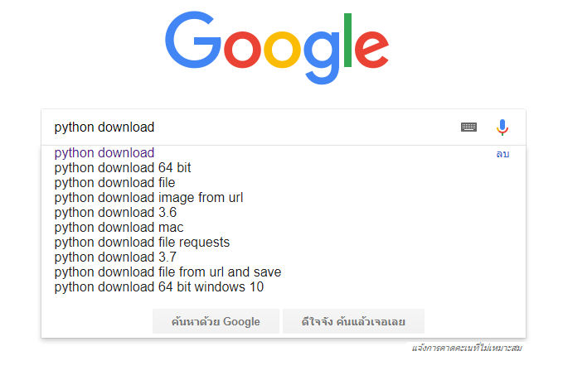
Downloading Python

Slide 33
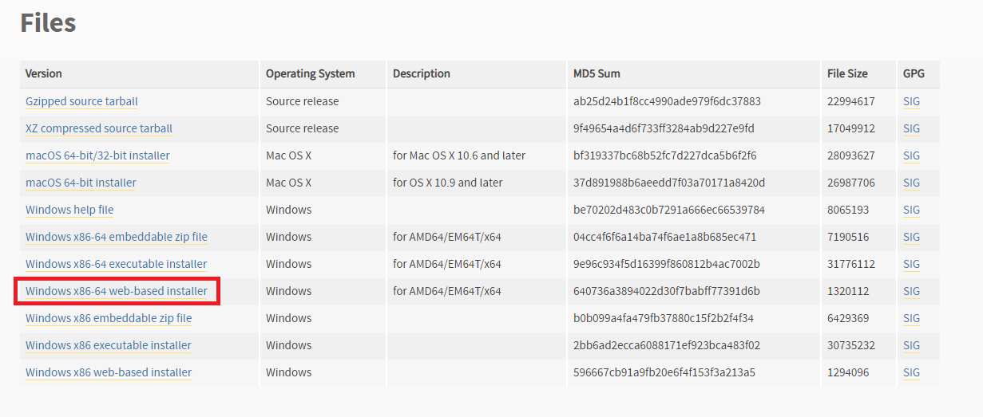
Downloading Python (3.6.x)

Slide 34
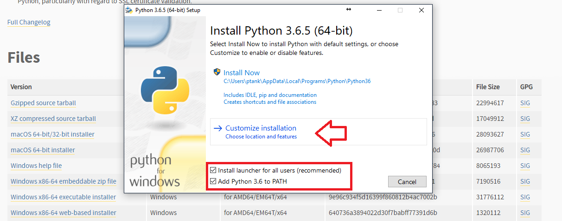
Installing python

Slide 35
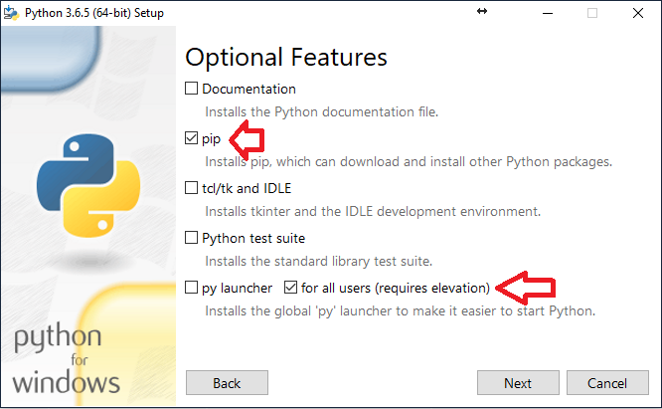
Installing python

Slide 36
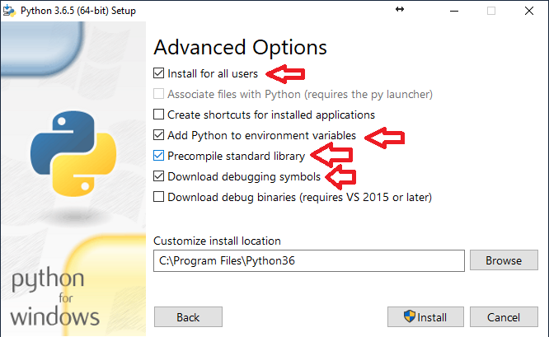
Installing python

Slide 37
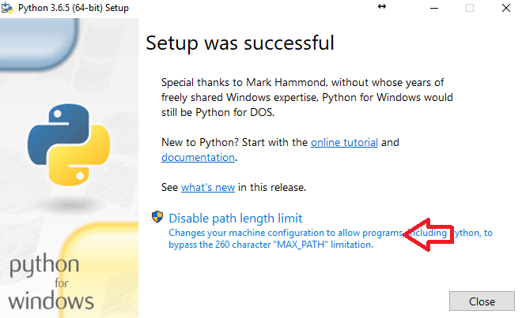
Installing python

Slide 38
Let’s install some packages
(jupyter) Jupyter Notebook : Workspace
(pandas) Pandas : 2D Data Tool for Data Analysis
(seaborn, matplotlib) Seaborn, Matplotlib : Visualization
(keras) Keras : Machine Learning Library Abstraction
Cmd (admin) > pip install jupyter pandas seaborn matplotlib keras

Slide 39
Let’s organize ourselves
Create a folder for our data and script
Open Notepad and put this in
E: - Only if the folder is not on C:
cd E:\Notebook - Change this to the folder’s directory
jupyter notebook
Save the file as Jupyter.bat so we don’t have to type it every time

